Slide 1
Classification of musical genres Final project for Applied Machine Learning 2020
Eliot, Mads and Sofus

Slide 2
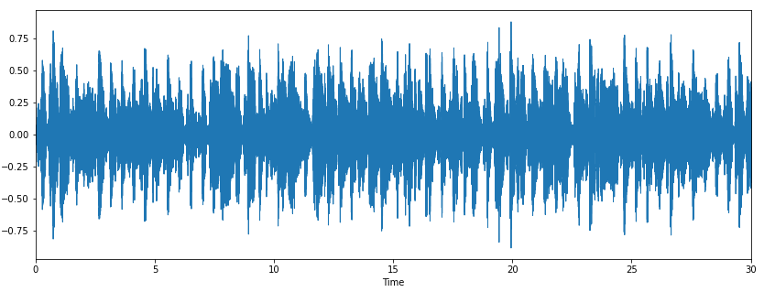
Finding features
We use the GITZAN dataset [1]
1000 songs in 10 genres: pop, jazz, blues, classical, hiphop, metal, rock, reggae, disco, country
Decided it was fun to find our own features and use a bunch of different approaches
Use Timbre and Librosa python packages
train_features =
Librosa: zerocrossing, spectralrolloff, chromagramstd,
chromagrammean, chroma_cens
Timbre: hardness, depth, brightness, roughness, warmth,
sharpness, boominess
Additional: fourier_std, fourier_mean

Slide 3
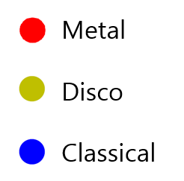
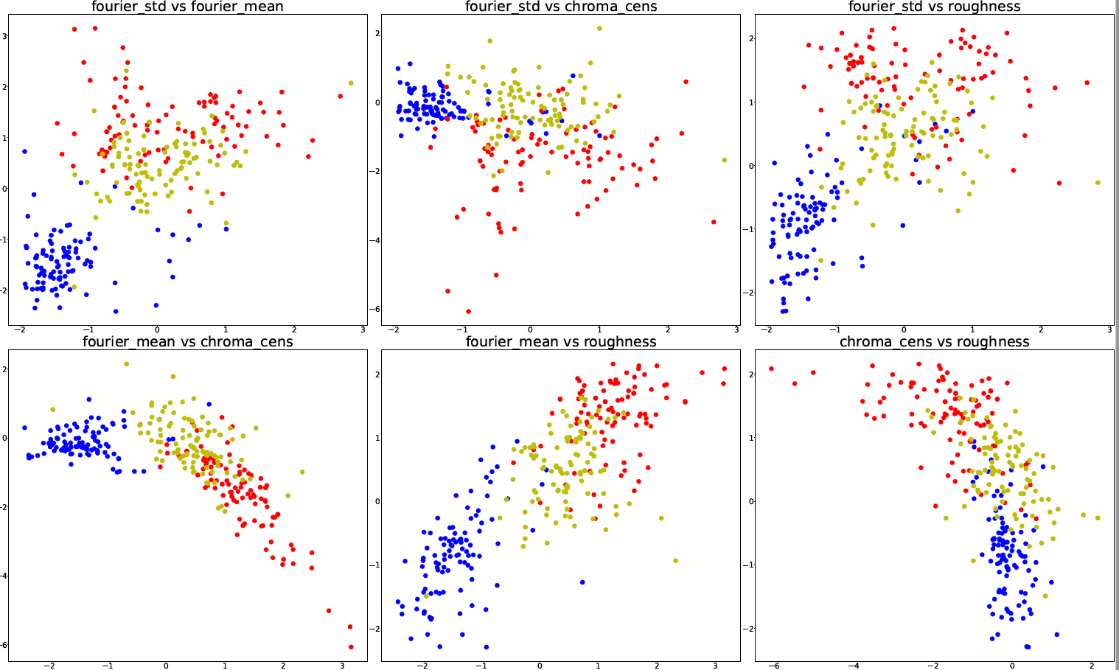
The initial approach: Gradient boosted tree and Nearest Neighbor
For three genres, kNeighbour gives an
accuracy score of 0.99 +/- 0.04 with
50 fold cross validation
This drops to 0.55+/- 0.11 for 10 genres
For three genres, LightGBM classifier gives an accuracy score of 0.80+/- 0.03, but holds up better for more genres.

Slide 4
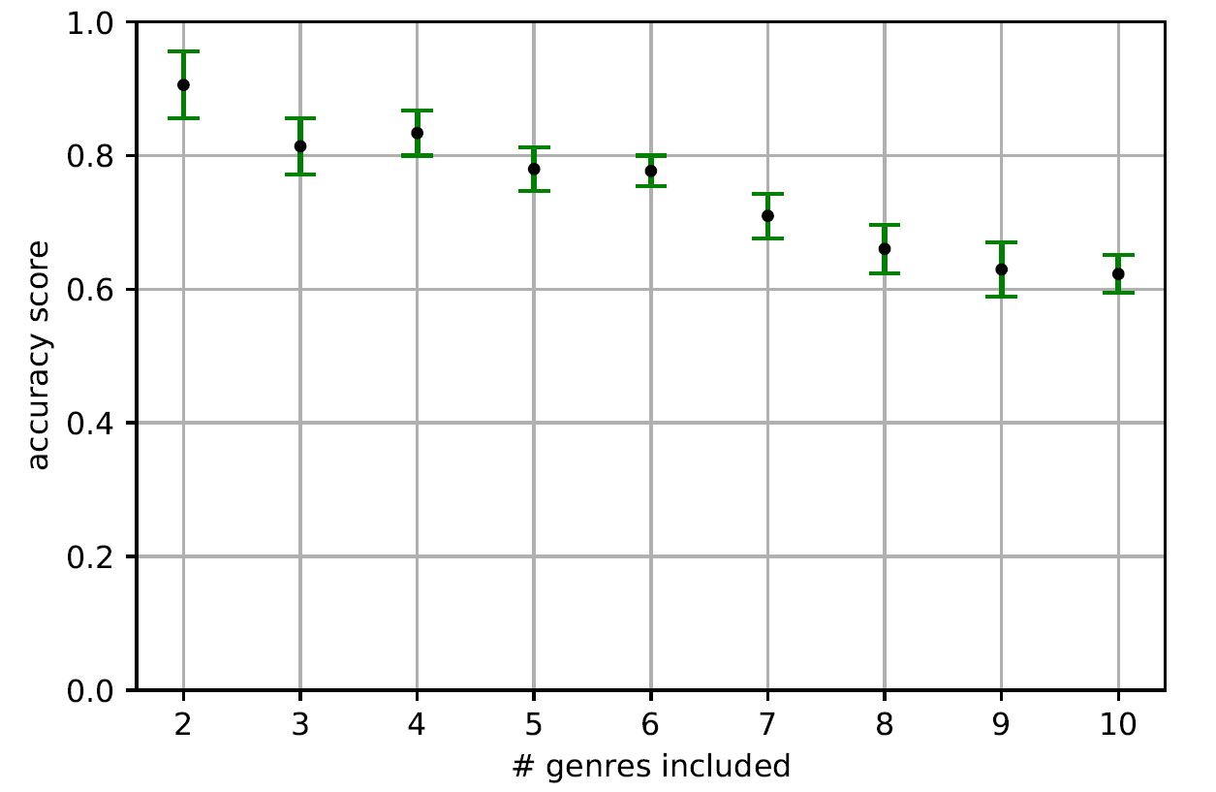
General decline in accuracy with inclusion of more genres
While some genres are easier to predict, the accuracy drops when more genres are added.

Slide 5
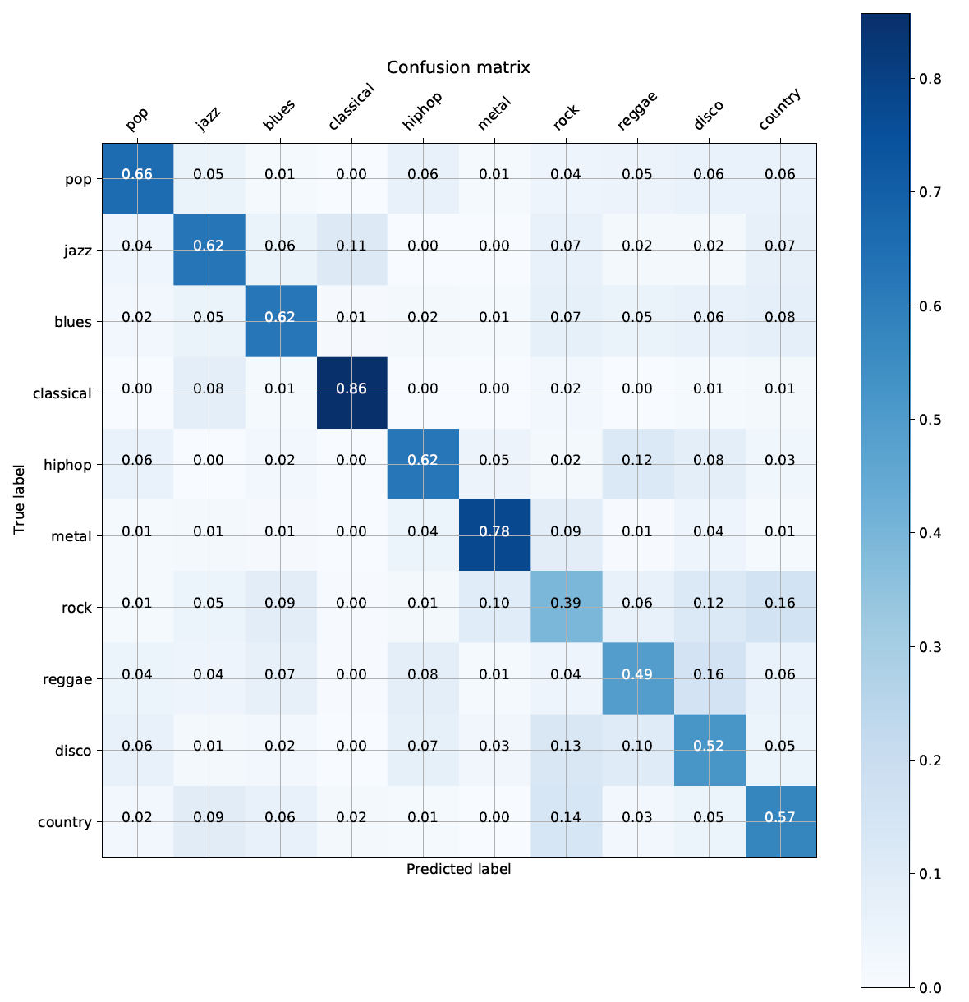
Finding errors in the prediction – what genres are hardest to predict?
Classical and metal are easiest to predict
Rock is hardest, which makes sense intuitively – vaguely defined!
Can we introduce variables that improves the guesses on the lowest scoring classes?

Slide 6
Appendix

Slide 7
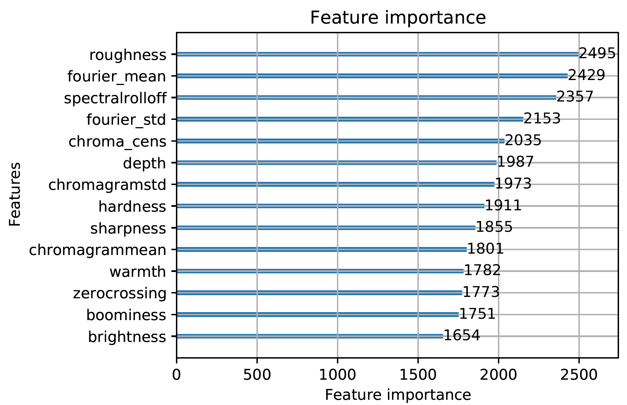
Feature importance of initial approach
The variables all contribute to the classification. Surprisingly, one of the most important variables is the mean of the fourier transform, done by hand.

Slide 8
Optimizing tree-based algorithm
We use LightGBM for the initial attempts at efficient classification.
The optimal parameters we found to be:
n_epochs = 500
n_leafs = 10
max_depth = 10
This yields a logloss of 0.3 for the multi-classification algorithm, using LightGBM cross validation.

Slide 9
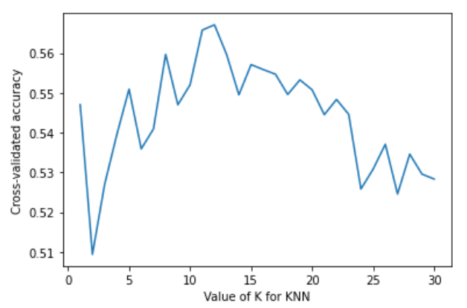
kNearestneighbor
The kNearestneighbor is very straight-forward and easy to use. This is the approach that many have used on the data set.
We use n_neighbors = 12, based on simple optimization.

